Slide 1
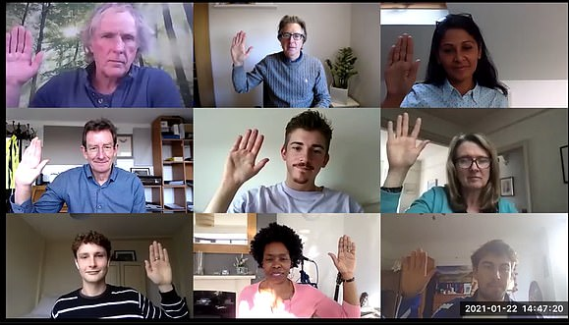
Hand Gestures to Control Video Call Features
The Covid-19 pandemic caused a surge in the use of video calls as many in person activities have been moved to online. (students that have shifted to online lectures which can affect their learning and grades)
Shift from in-person lectures to online too difficult or challenging to use.
Our idea’s goal is to ease users into online learning by using hand tracking to detect common hand gestures used in-person to control video call features. This allows them to easily control call functions and immerses them into the classroom.
Users that have trouble with online lectures will find our solution easier to use and less distracting. It can create a more natural flow for all users as their physical actions influence the video call.
Hand tracking technology has already been created that controls functions such as pulling, pushing, or pinching.
Hand gestures could make video calling more immersive and easier to control with the right implementation. Though they need to be distinct, clear and unable to be confused for each other or other basic human actions.
We have made a prototype that showcases what our idea is supposed to look like
Next steps include gathering a large amount of different gestures that can be inputted as options users may choose from, as well as determining which gestures feel the most natural, as well as testing the accuracy of hand tracking and trying to improve it
By: Jackie, Alvin and Maddin

